Slide 1
IMPACT OF DEVELOPMENTAL PROJECTS ON ENVIRONMENT
KVGCE TECH FEST – 2017
TANTRAJNA - 17
National Level Technical Fest for UG Students
By
Mushtaq Ahmed
Naveen Kumar
Students, Department of Civil Engineering
Shree Dharmasthala Manjunatheshwara Institute of Technology-Ujire

Slide 2
Bird’s View
Introduction
Objective
Case Studies - Study Area
Discussion
Inference
References

Slide 3
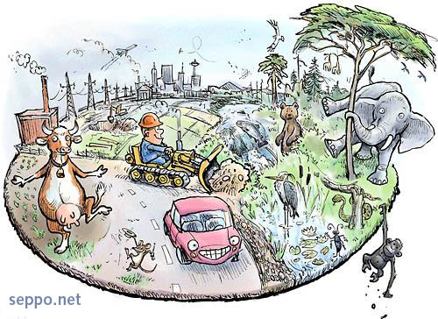
Left behind environment in search of development….
GDP α Developmental Projects α Environmental Clearances
Always been a steady increase in declination of healthy environment;
But there is always a way where there is will
EIA and HIA
I don’t want to protect environment, I want to create a world where environment doesn’t need protection

Slide 4
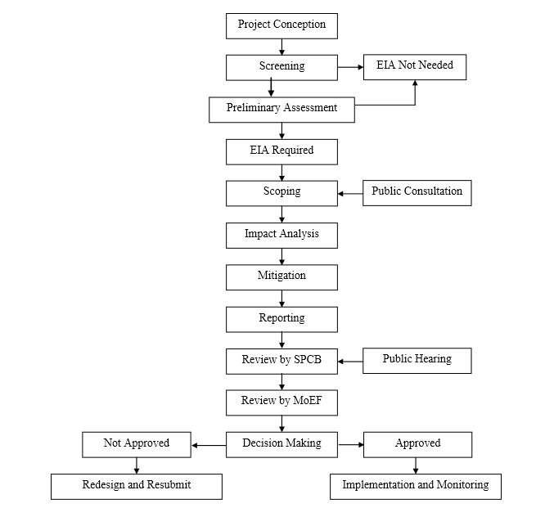
Process of Clearance
Courtesy: MoEF (2006)

Slide 5
OBJECTIVE
To throw some light on the impacts of developmental projects on environment; and
Case studies of three projects in the Western Ghats of Karnataka.

Slide 6
Case Studies
1. Thermal Power Station at Udupi.
2. Yettinahole Project at Hassan.
3. Gundya Hydro power project at Hassan and Dakshina Kannada.

Slide 7
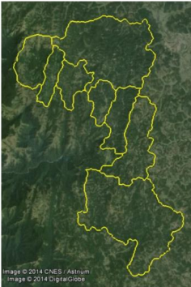
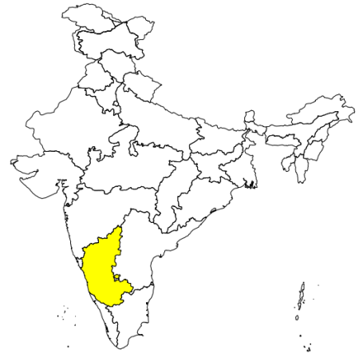
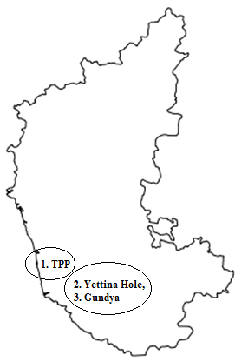
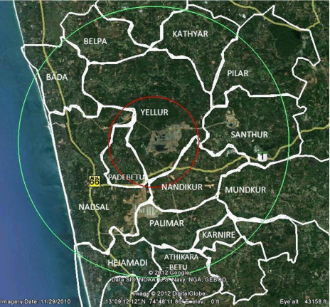
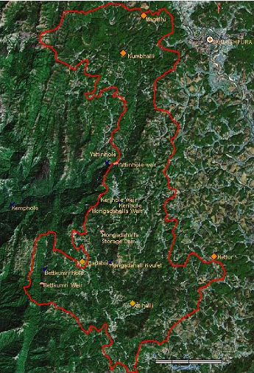
Study Area
2. Yettina Hole Catchment
Karnataka
1. Thermal Power Station at Nandikuru
Source: [1], [2] and [3]
3. Gundya Catchment

Slide 8
Thermal Power Plant (TPP) - Nandikuru, Udupi
On the other side of a mirror…..
Unscientific effluent management: both liquid and fly ash;
Stress on ground water;
Phonological changes in plants; crop yield variations;
Socioeconomic imbalance due to decreased cash crop yield
Salinity intrusion into groundwater.
A coal based - Thermal Power Plant (TPP) - capacity 1000 MW - Nandikur village -1996 -NPCL;
Another TPP - Capacity 1200 MW - 2003 - same region.
Coal Power
Started Functioning - 2010

Slide 9
Yettinahole Water Supply Diversion Project - Hassan
On the other hand
107.27 Hectares of forest gone (T.V.R. DPR Vol.2)
Loss of endemic and endangered species
Increasing man animal conflicts
Extremely damages the downstream ecology
Alteration of hydrological regime
ನೋಟವೊಂದು ರೂಪ ಹಲವು
Proposal floated by G.S.Paramashivayya
Yettinahole dam site - Sakleshpura - Total catchment area 179.68 km2
Aim - Providing drinking water - Kolar, Chikkaballapur, Hasan, Tumkur, Bangalore Rural and Ramanagar districts by lifting 24 TMC from Yetttinahole catchment.
Where is 24TMC ? (T.V.R DPR)
Availability of water - 9.55 TMC
9.55 TMC ̶ 8.68 TMC = 0.87 TMC
8.68 TMC
5.84 TMC
2.84 TMC
Demand for crop water requirement
Domestic water requirement
Livestock water requirement
Evaporation losses etc.
Environmental flow

Slide 10
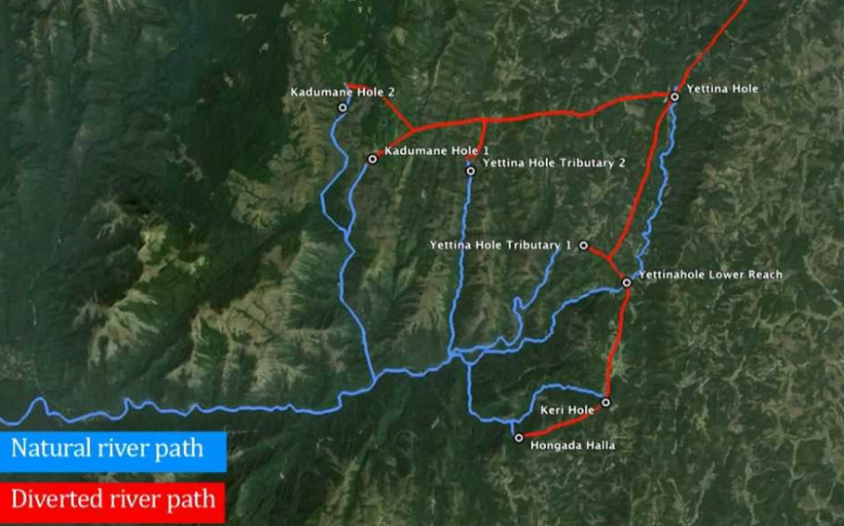
Courtesy: Google

Slide 11
Gundya Hydel Power Project
Worst Side
Project envisages submergence of 700 hectares land, including 400 hectares Forest Land.
Submergence of patches of riparian forest.
The drying up of down streams -Yettinahole, Kerihole, Hongadahalla and Bettakumari before joining Gundia river
Protected hills such as the Pushpagiri and Brahmagiri, which has medicinal plants, would be affected.
Gundya Hydel Power Project - KPCL - Hassan and Dakshina Kannada.
Total Power – 400MW.
Yettinahole, Kerihole, Hongadhalla and Bettakumari.
Water Transfer -Tunnel - Balancing Reservoir - Underground Powerhouse at Gundya.
Two phases: Phase I - 1x200 MW and
Phase II - 1x200 MW.

Slide 12
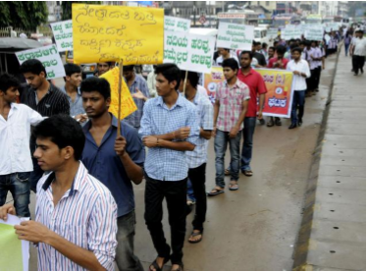
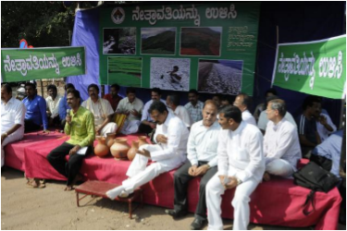
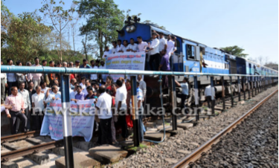
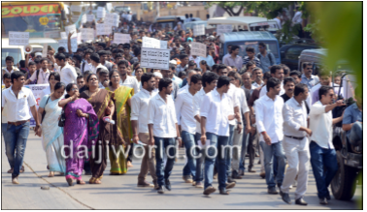
DISSCUSSIONS
NEW AVATAR, OLD PROBLEMS
A POLITICAL PORTRAIT
In the past -Scheme - ‘Diversion of flood water from Sakleshpura (West) to Kolar/ Chikkaballapura Districts (East)’ - successfully opposed
Now again , under the name of Yettinahole water supply project.
A political project - to earn political mileage.
Despite of many protests, foundation stone has been laid and the work has been started
Courtesy: SANDRP Yettinahole Diversion DPR: New Avataar, old problems

Slide 13
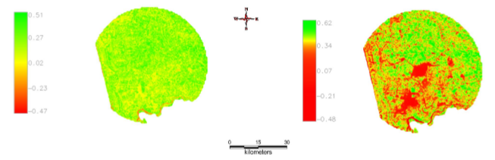
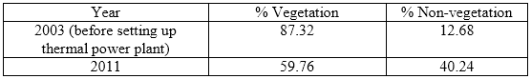
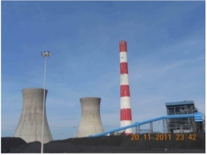
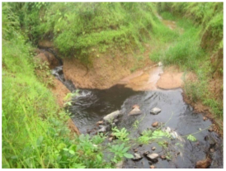
Whack on Environment
Due to TPP
2003
2011
Open coal stockyard at TPP
Coal mix effluents released into a natural stream near to coal stockyard

Slide 14
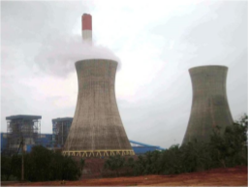
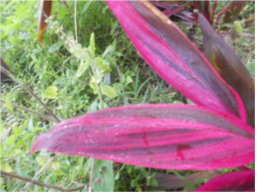
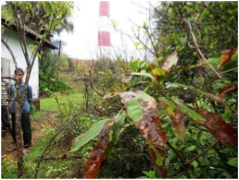
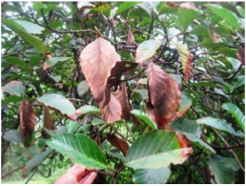
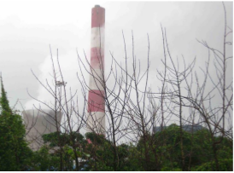
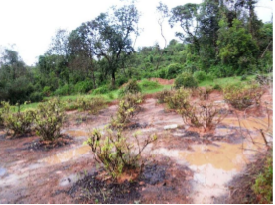
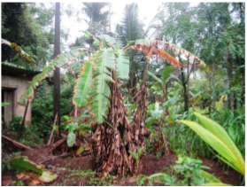
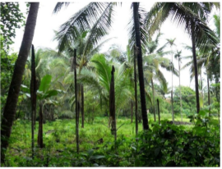
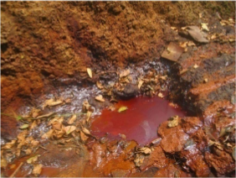
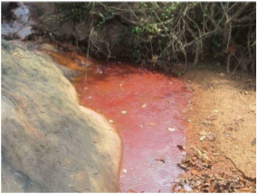
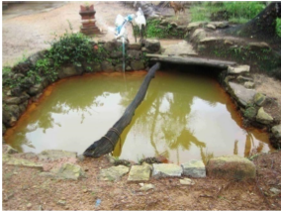
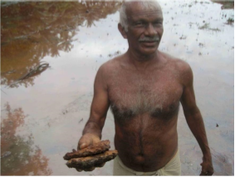
Saline mist discharge from cooling tower of TPP and deposition on leaves and burning
Reduced productivity of jasmine, banana, coconut, areca, etc
Hydrocarbon rich oily effluents infiltrating to northwestern side of TPP affecting the nearby wells and agricultural fields

Slide 15
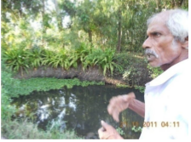
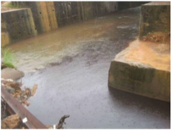
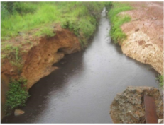
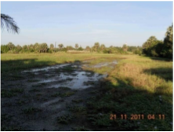
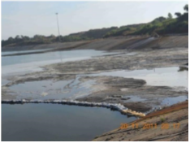
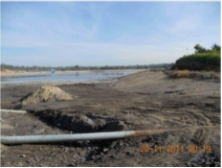
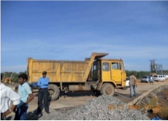
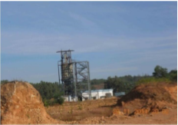
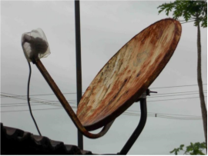
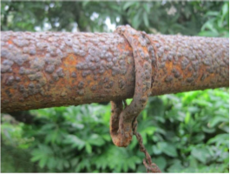
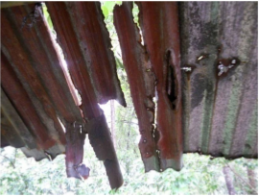
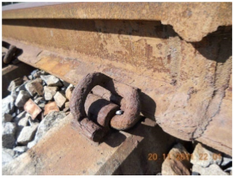
Effluents mixing with a perennial stream in southwestern side of TPP (Yellur village)
Ash pond site (open truck, non-functional ash sluicer, ash pond)
Corrosion of metallic objects (dish antenna, roof tops, transmission wire, railway track)

Slide 16
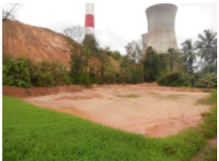
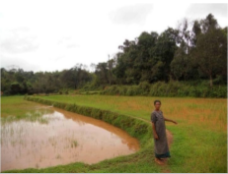
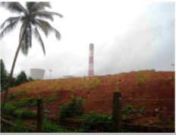
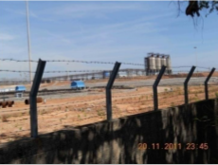
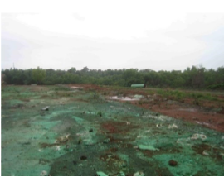
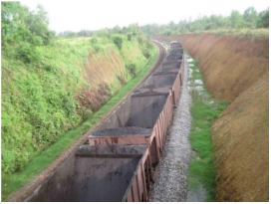
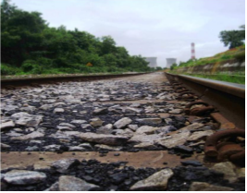
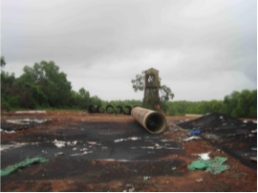

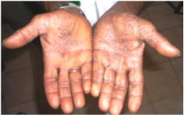

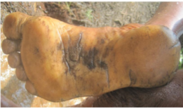
Soil erosion from northern side of TPP complex and deposition nearby paddy fields, Yellur
Glimpse of poor vegetation cover at TPP complex
Open wagons transporting coal to the TPP via Konkan Railway and coal spillage
Soil contamination due to disposal of synthetic material used for outer coating of sea water intake GRP pipeline
Health issues, Skin lesions, nail deformations, etc observed in people

Slide 17










Inferences
....ज़िंदगी और सदी के इस बदल में हम नहीं बदले

Slide 18
REFERENCES
[1] T.V.Ramachandra, S. Vinay, B.H. Aithal, “Environmental Flow Assessment in Yettinaholé, Where is 24 TMC to divert?”Sahyadri Conservation Series 48, ETR 91, 2015.
[2] T.V.Ramachandra, B.H. Aithal, “Land Use Dynamics at Padubidri, Udupi District with theImplementation of Large Scale Thermal Power Project”, International Journal of Earth Sciences, pp.409-417, 2012.
[3] T.V. Ramachandra, S.P. Bhat, D.M. Mahapatra, B.H. Aithal, Y. B. Ramakrishna, G. Krishnadas,“Environmental Profile and People’s Livelihood Aspects in the Vicinity of Coal Based Thermal Power Plant at Yellur Panchayat, Udupi District”. CES Technical Report 126, 2012.
[4] S. Banerjee, S. Madan, “Green Norms for Green Energy”,Centre for Science and Environment, 2013.
[5] G. Kiran Kumar., R. Sandeep, Chandemo Tungoe, T. Suresh, “A Study on Feasibility of Diversion of River Netravati at Gundya”, An unpublished project thsesis submitted to The National Institute of Engineering, Mysore, Guided by Prof. Mysuru R. Yadupathi Putty, 2012.
[6] Smakhtin, Vladimir. "Environmental flows: a call for hydrology." Hydrological Processes 21.5 (2007): 701-703. [7] Al-Iriani, Mahmoud A. "Energy–GDP relationship revisited: an example from GCC countries using panel causality." Energy policy 34.17 (2006): 3342-3350. [8] Kochhar, Kalpana, et al. "India's pattern of development: What happened, what follows?." Journal of Monetary Economics 53.5 (2006): 981-1019.

